Slide 1
High Performance Computing Opportunities and Challenges
Module 29-30

Slide 2
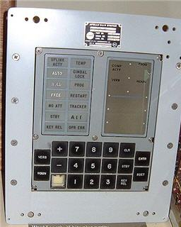
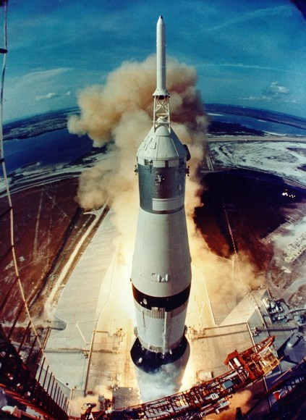
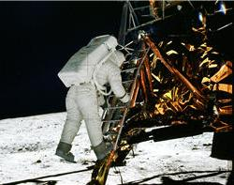
A little perspective…
Apollo 11’s Guidance Computer Specification: Designed at MIT and built by Raytheon; A rudimentary real time operating system ;

Slide 3
Apollo Guidance Computer, Block II (1965)
Memory (ROM): 36,864 words @ 16 bits (73,728 bytes) Memory (RAM): 2,048 words @ 16 bits (4,096 bytes) Clock Speed: 1 MHz Transistors: 16,800
Volume: 0.97 ft3 Weight: 70 lbs Power Consumption: 55 Watts

Slide 4

And now…
Samsung Galaxy S4 phone has two quad-core Samsung made Exynos processors or in the US market Qualcomm Snapdragon 600 quad core processor running at 1.6GHz
RAM: 2GB and HD 16GB – expandable to 64GB
State of the art graphics processor capable of rendering life like 3-D graphics
Good battery life of 9 hours of continuous video use

Slide 5
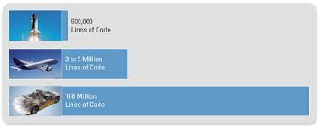
Relentless hunger for computing power…
Space shuttle
Boeing 787
Top segment Car
Premier Segment car now has 75 – 100 processor units
30% - 40% of the car price is due to electronics and related software

Slide 6
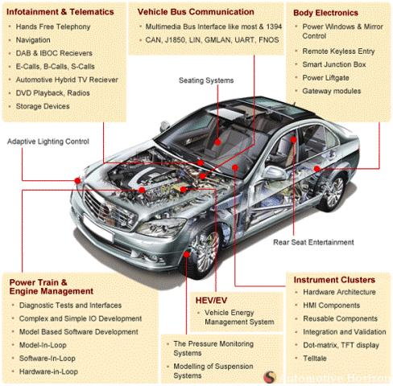

Slide 7
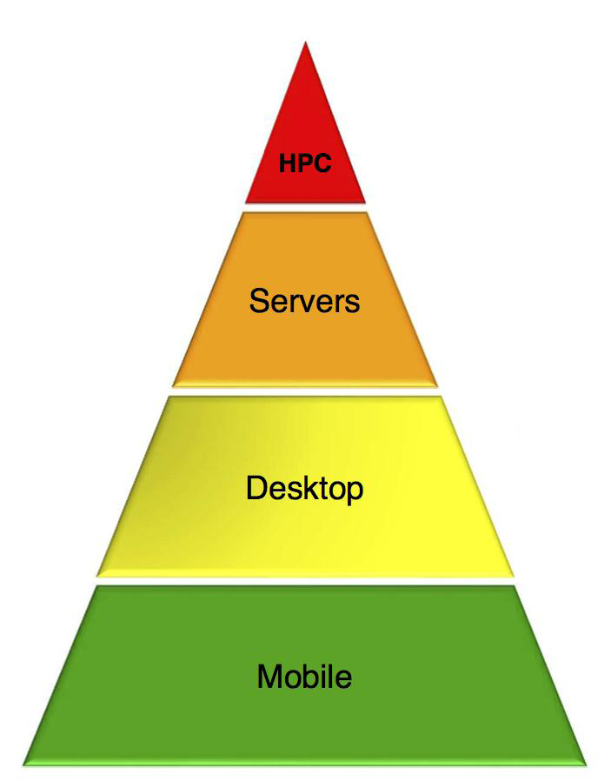
Historical view
Introduction of a new category
High Performance Computing (HPC)
Desktop/Laptop/Server
Intel
Smartphones (MID)
Embedded System
ARM
Raw performance of 1970’s super computer is now available on a mid-range smartphone!!

Slide 8
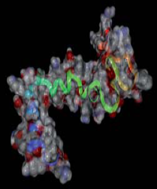

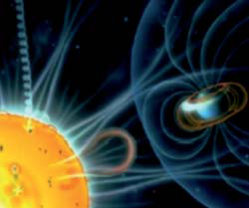
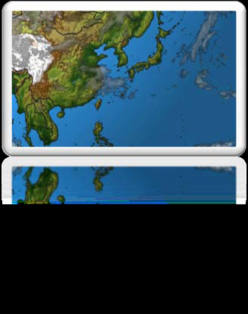

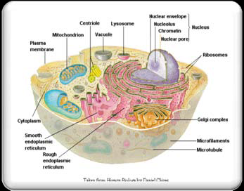
What do we need?

Slide 9
History of Processor Development
Pre 2001: Mainly single core processors and this segment mainly dominated by Intel, AMD and IBM
Strictly following Moore's law
Between 1994 and 1998, CPU frequency increased by 300%
Between 2007 to 2010, frequency increased only by 33%
Lately it is becoming difficult to improve performance just by increasing frequency

Slide 10
Heating…

Slide 11
Software
Operating System, System software, Compiler
Computer Science
Instruction Set Architecture (ISA)
Register, Data path, I/O Control
Gate Level
Electronics / VLSI
Transistor Level
Device Physics Level

Slide 12
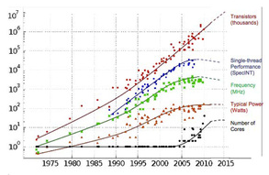

Slide 13
A new way of thinking…
Taking a page out of traditional HPC cookbook!
Enter the multi-core era!
Brings in a Paradigm Change in thinking about hardware and software co-development
In the high end HPC area the goal is to achieve “Exascale” computing while remaining within a given power envelop.

Slide 14
What is tera, peta and exa?
Prefix | Symbol | Power of 10 | Power of 2
mega- | M | 10⁶ | 2²⁰
giga- | G | 10⁹ | 2³⁰
tera- | T | 10¹² | 2⁴⁰
peta- | P | 10¹⁵ | 2⁵⁰
exa- | E | 10¹⁸ | 2⁶⁰
zetta- | Z | 10²¹ | 2⁷⁰
yotta- | Y | 10²⁴ | 2⁸⁰

Slide 15
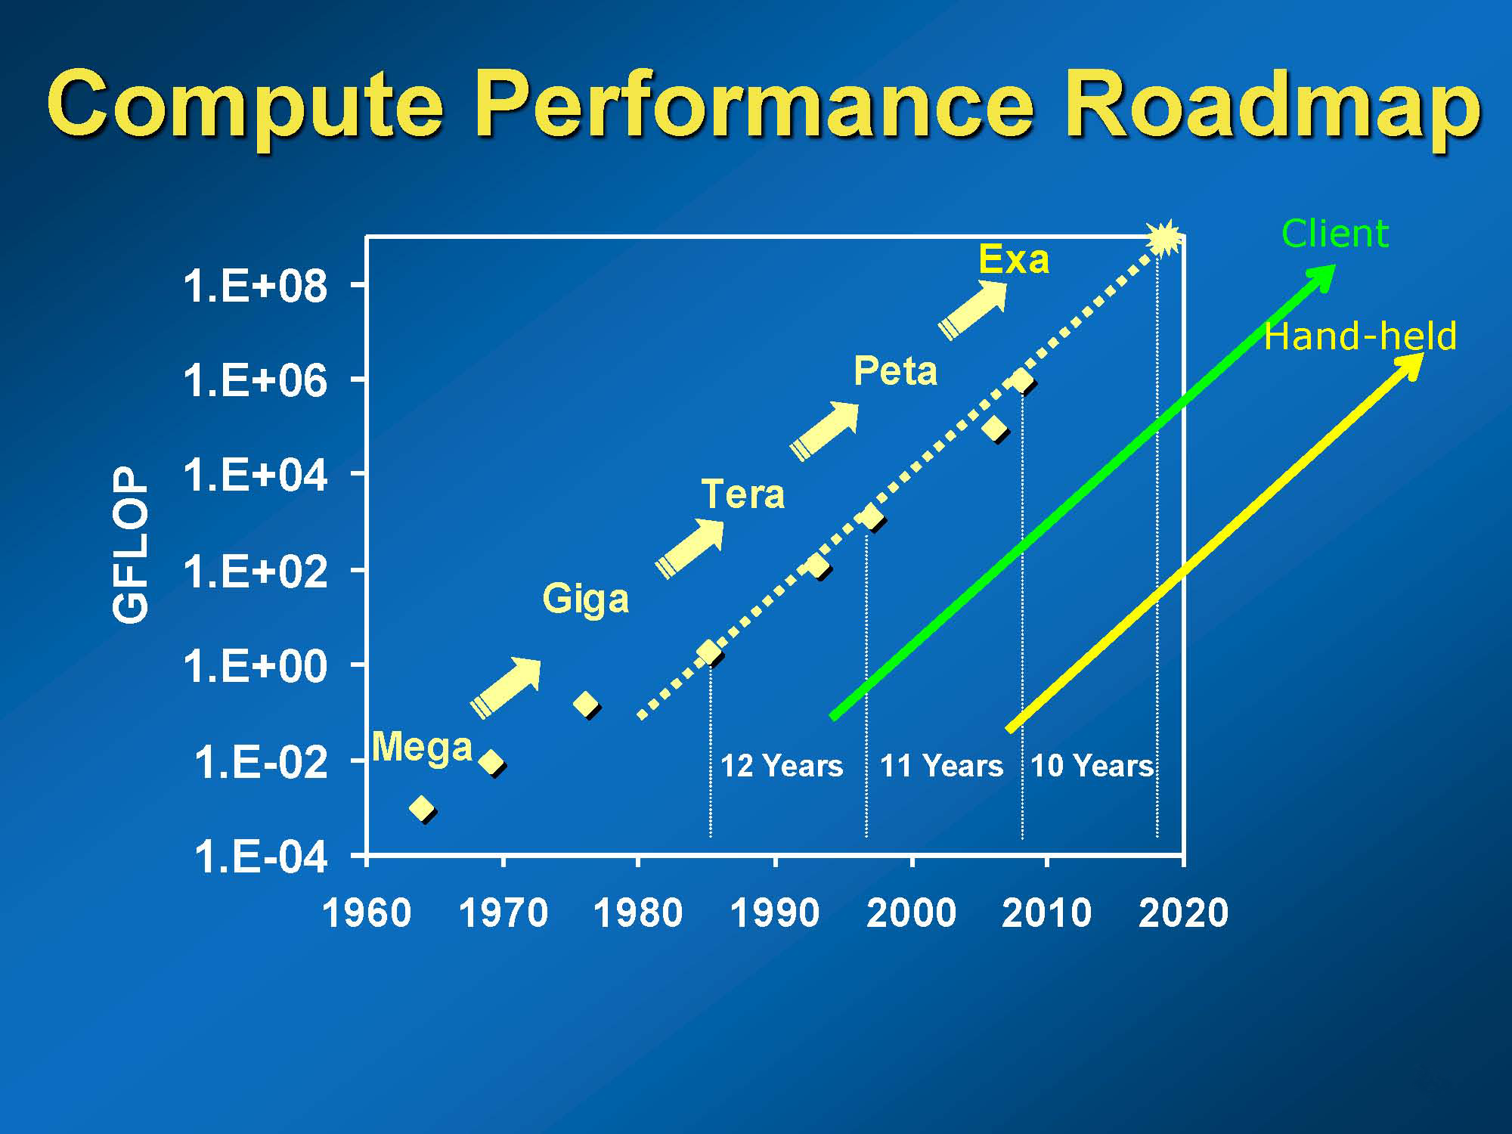

Slide 16
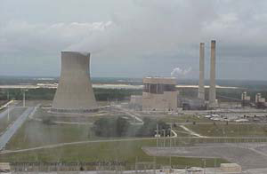
Exa Scale challenge (energy)

Slide 17
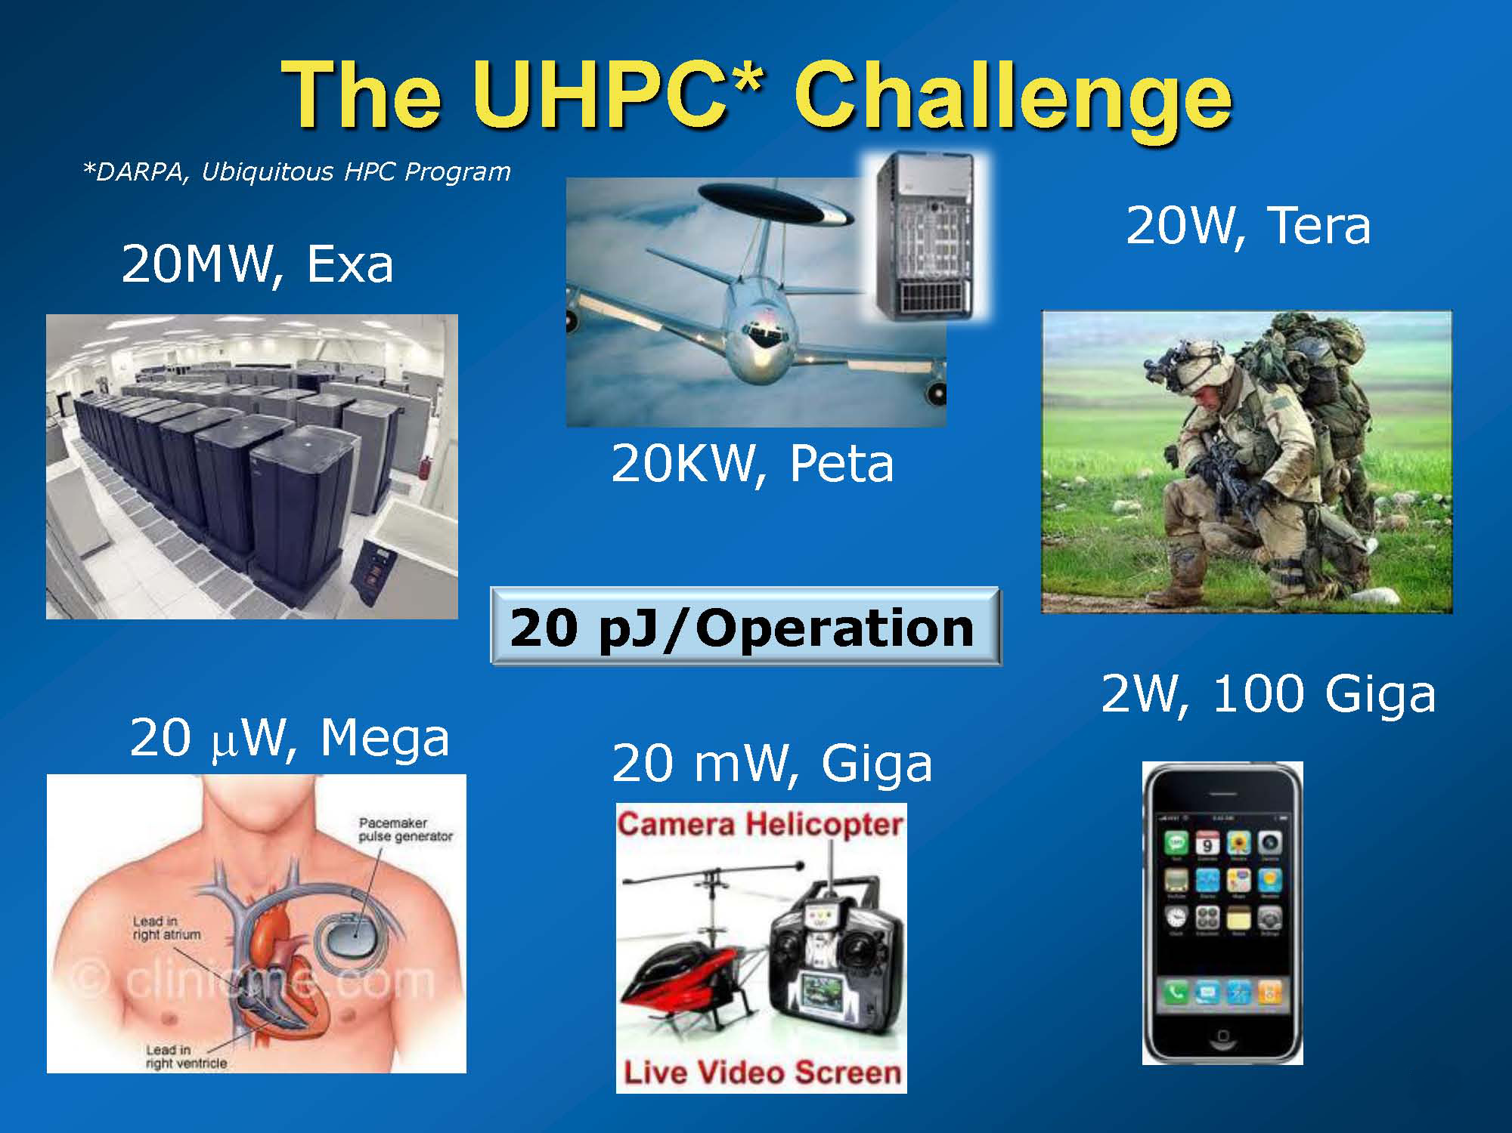

Slide 18
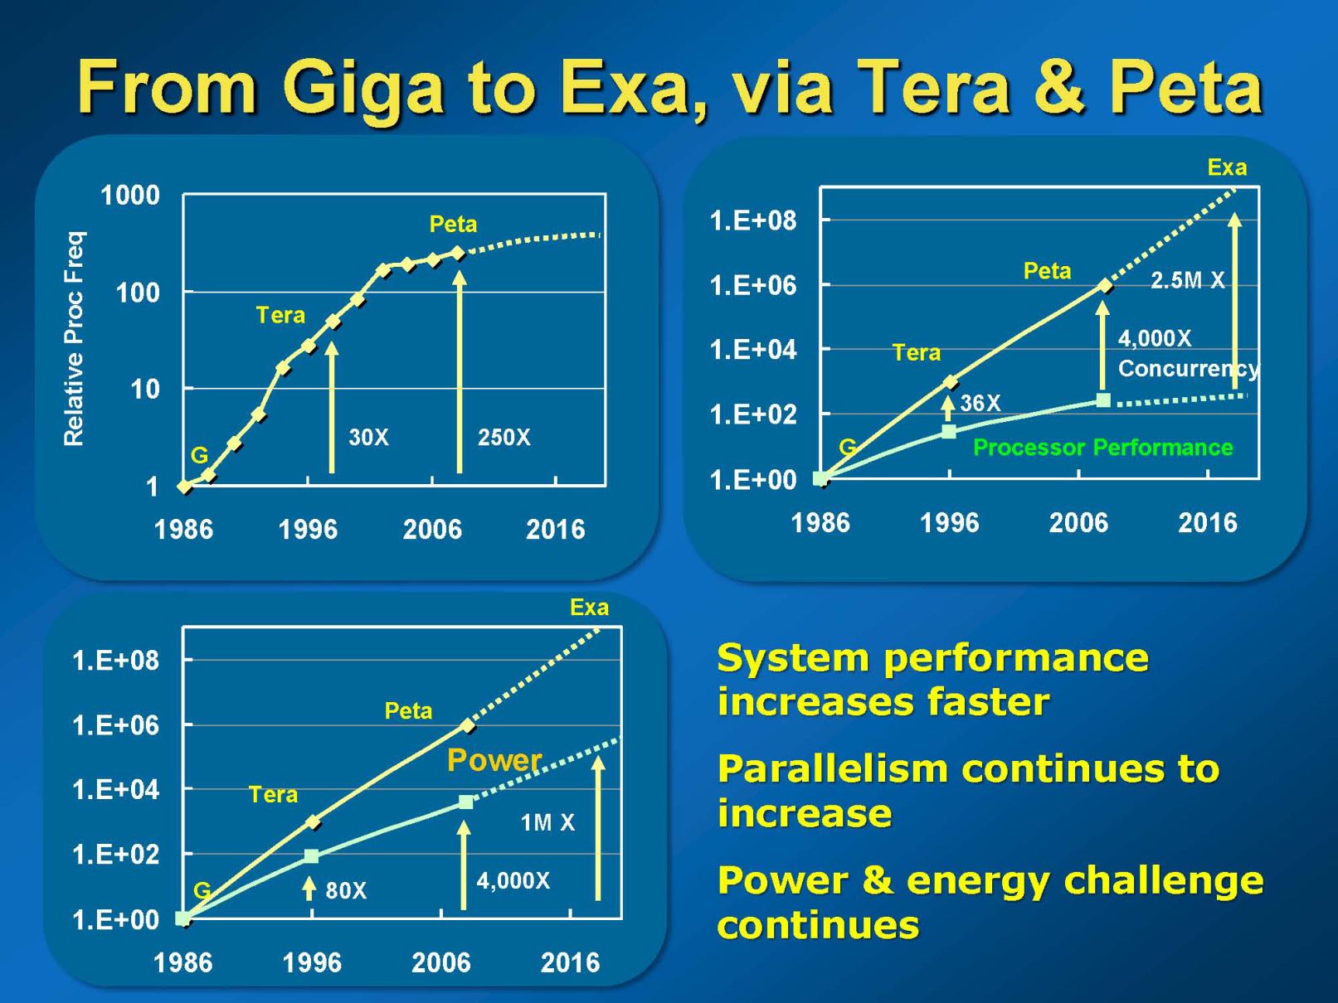

Slide 19
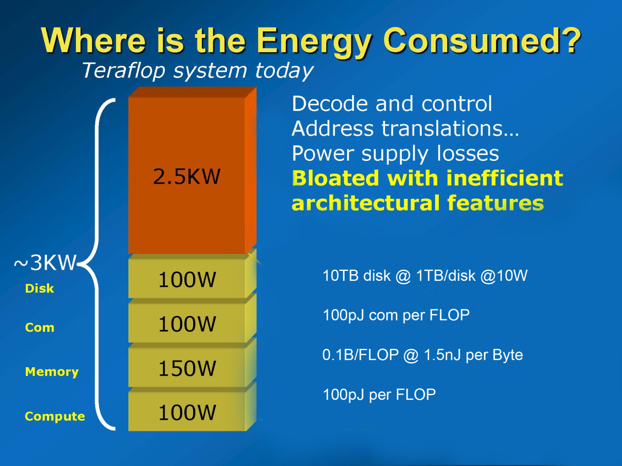

Slide 20
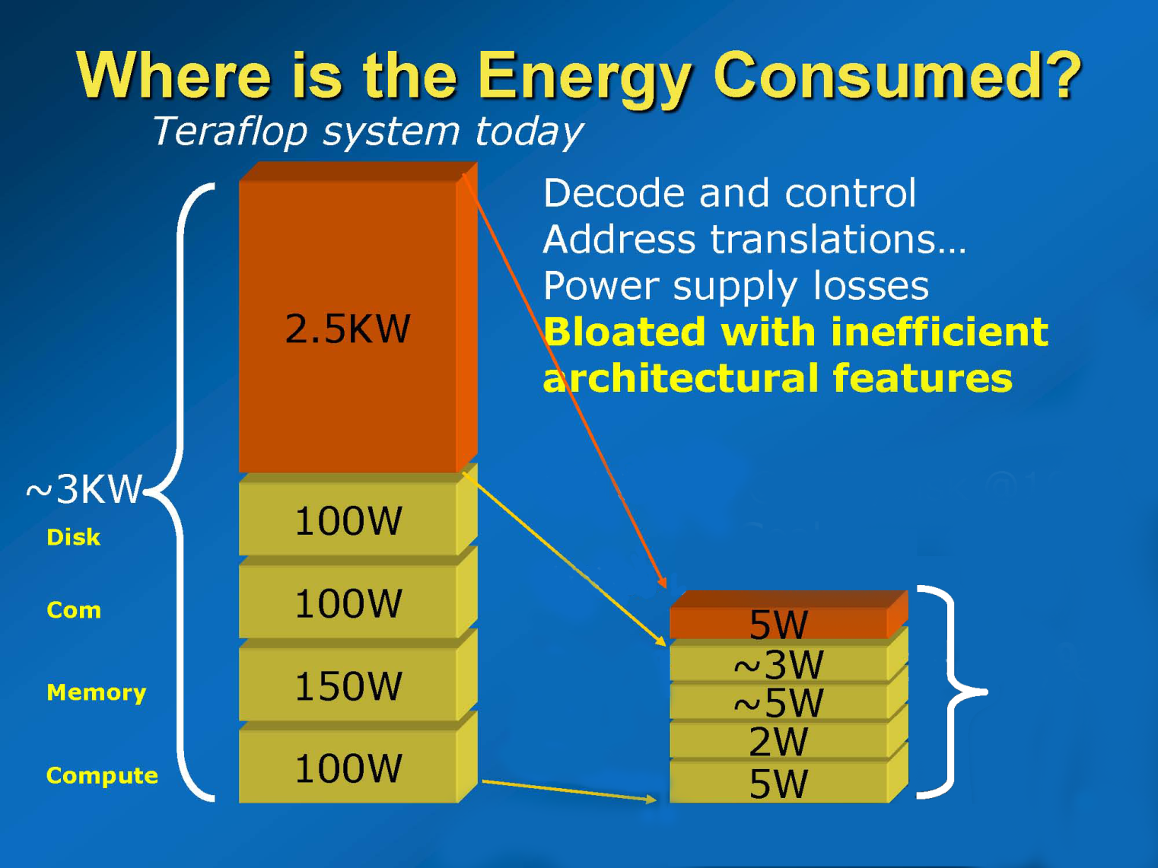
~20 W

Slide 21
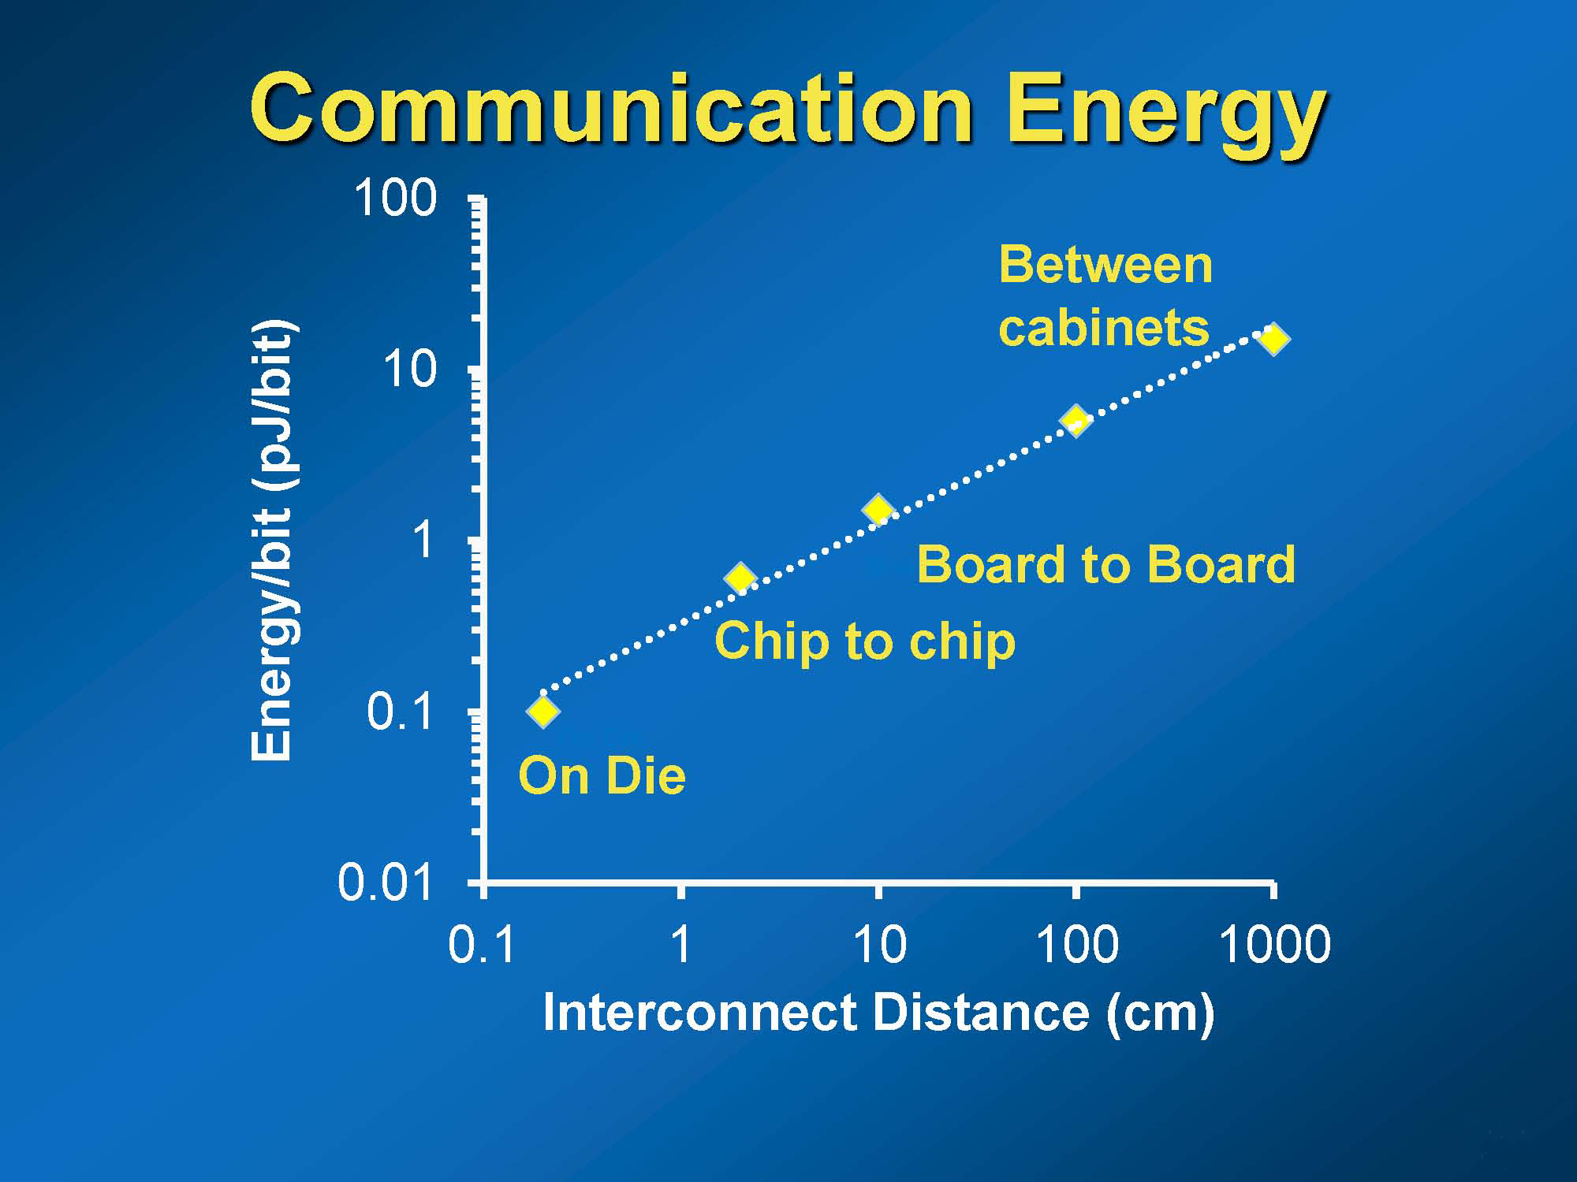

Slide 22
long-term efforts on rethinking of the canonical computing “stack”—applications, programming language, compiler, runtime, virtual machine, operating system, hypervisor, and architecture—in light of parallelism and resource-management challenges.

Slide 23
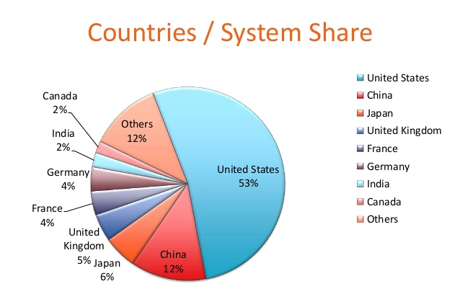
Countries having top 500 supercomputers

Slide 24
Top 5 super computers in the world
 | Site | System | Cores | R max in TFlops | Rpeak in RFlops | Power in watts
1 | National Super Computer Center in Guangzhou China | Tianhe-2 (MilkyWay-2) - TH-IVB-FEP Cluster, Intel Xeon E5-2692 12C 2.200GHz, TH Express-2, Intel Xeon Phi 31S1P NUDT | 3,120,000 | 33,862.7 | 54,902.4 | 17,808
2 | DOE/SC/Oak Ridge National Laboratory United States | Titan - Cray XK7 , Opteron 6274 16C 2.200GHz, Cray Gemini interconnect, NVIDIA K20x Cray Inc. | 560,640 | 17,590.0 | 27,112.5 | 8,209
3 | DOE/NNSA/LLNL United States | Sequoia - BlueGene/Q, Power BQC 16C 1.60 GHz, Custom IBM | 1,572,864 | 17,173.2 | 20,132.7 | 7,890
4 | RIKEN Advanced Institute for Computational Science (AICS) Japan | K computer, SPARC64 VIIIfx 2.0GHz, Tofu interconnect Fujitsu | 705,024 | 10,510.0 | 11,280.4 | 12,660
5 | DOE/SC/Argonne National Laboratory United States | Mira - BlueGene/Q, Power BQC 16C 1.60GHz, Custom IBM | 786,432 | 8,586.6 | 10,066.3 | 3,945
Notes:
Rmax = maximum LINPACK performance achieved. LINPACK was developed by Prof Jack Dongara. It involves solving a dense system of linear equations. It would check floating point performance of the computer

Slide 25
 |  | Cores | Rmax TFLOPS | Rpeak TFLOPS | Power in KW
44. Indian Institute of tropical meteorology | iDataPlex DX360M4, Xeon E5-2670 8C 2.600GHz, Infiniband FDR | 38016 | 719.2 | 790.7 | 790
83. CDAC | PARAM Yuva - II - R2208GZ Cluster, Xeon E5-2670 8C 2.600GHz, Infiniband FDR, Intel Xeon Phi 5110P | 30056 | 388.4 | 520.4 | 210
99. CSIR-4PI | Cluster Platform 3000 BL460c Gen8, Xeon E5-2670 8C 2.60GHz, Infiniband FDR | 17408 | 334.4 | 362.1 | 387
106. National Center for Medium Range Weather | iDataPlex DX360M4, Xeon E5-2670 8C 2.600GHz, Infiniband FDR | 16832 | 318.4 | 350.1 | 350
130. IIT-Kanpur | Cluster Platform SL230s Gen8, Intel Xeon E5-2670v2 10C 2.500GHz, Infiniband FDR | 15360 | 282.6 | 307.2 | 316
225. ISRO | SAGA - Z24XX/SL390s Cluster, Xeon E5530/E5645 6C 2.40GHz, Infiniband QDR, NVIDIA 2090/2070 | 12532 | 188.7 | 394.8

Slide 26
Conclusion
Our academic institutions have to adopt their curriculum to suit the current and future need
Parallel programming paradigm has to be adopt and research work needs to be focused in that area
Hardware – Software co design paradigm needs to be looked at and adopted

